Slide 1
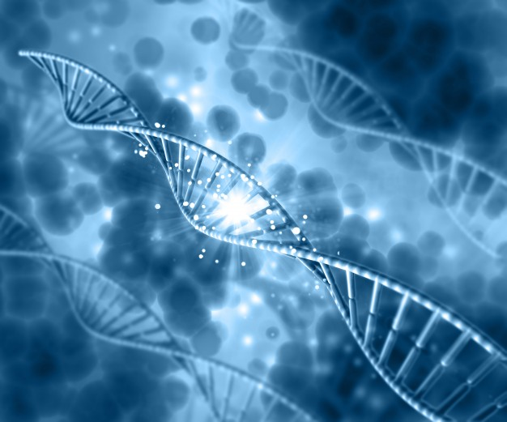
GENE-ius
Team Workshop

Slide 2
Practice Problems
DNA Structure
Codon Reading
Karyotype Analysis
Punnett Squares
Pedigree Analysis
Human ABO Blood Group Genetics

Slide 3
Format
Review
Practice problems as a team
Go over answers

Slide 4
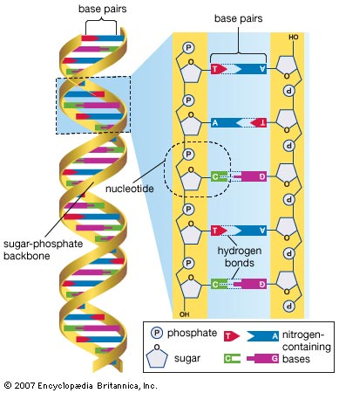
DNA Structure
DNA - deoxyribonucleic acid
2 strands form a double helix
Each strand is made of stacks of
nucleotides
Each nucleotide is made up of a:
phosphate
deoxyribose
one of the 4 bases (A, C, G or T)

Slide 5
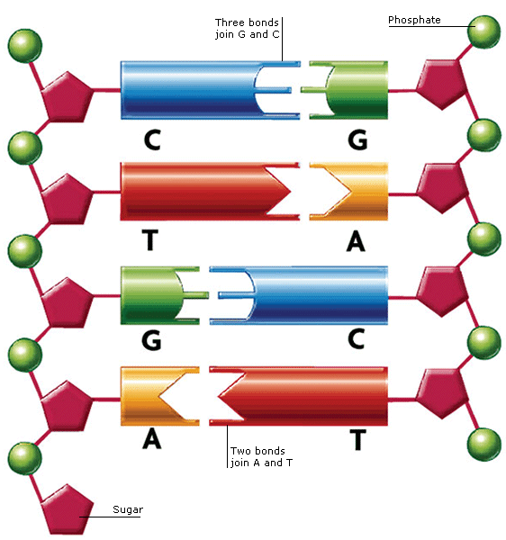
Base Pairing Rule
Adenine - Thymine
Guanine - Cytosine

Slide 6
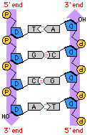
Antiparallel Nature of the
Double Helix
The two strands of the double helix
run in opposite directions.
The end of the strand with a free
phosphate is the 5’end.
The end of the strand with a free
sugar will be referred to as the 3’ end.
Notes:
Explain how that these are actually referred to as 3’ and 5’ but that we wanted to simplify the terminology for the kids.

Slide 7
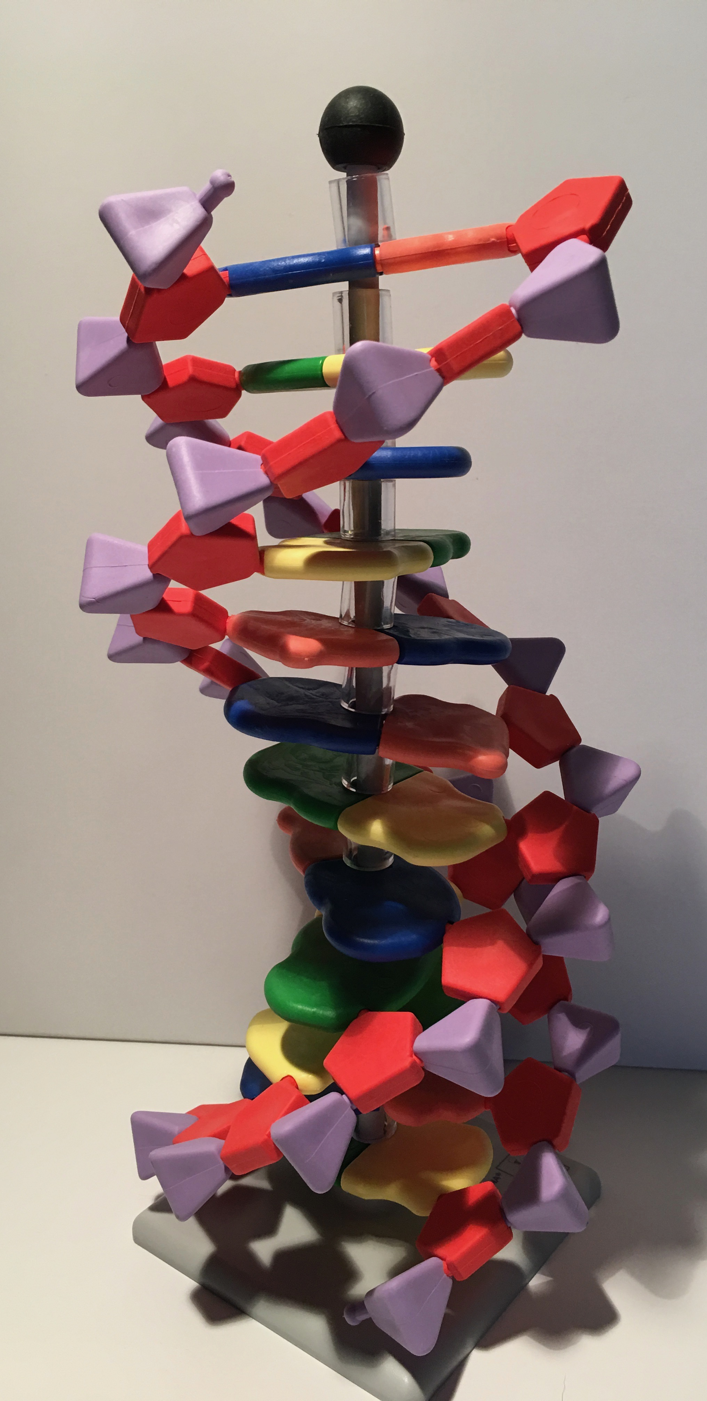
5’ Phosphate
3’ Deoxyribose

Slide 8
DNA Model Questions

Slide 9
DNA Model Answers
A nucleotide is composed of 3 parts:
(in any order)
a. Phosphate
b. Deoxyribose
c. Base

Slide 10
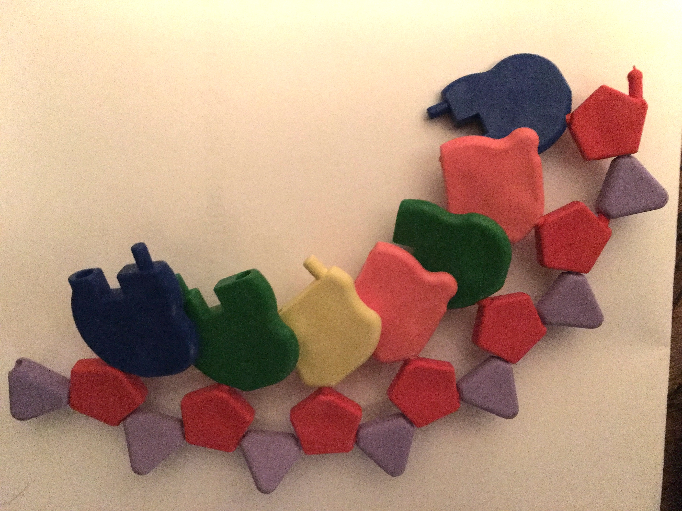
DNA Model Answers
II. Using the DNA model kit, construct a single strand of DNA in the 5’ to 3’ direction with the following sequence:
A G C T G T A

Slide 11
DNA Model Answers
II. What would be the sequence of the complementary strand of the above sequence in the 5’ to 3’ direction?
5’ A G C T G T A 3’
3’ T C G A C A T 5’
5’ T A C A G C T 3’

Slide 12
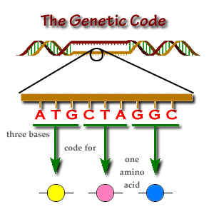
Codon Reading
The DNA sequence of a specific gene serves as a “code” or instructions for arranging amino acids in a specific combination to form a protein.
These proteins go on to perform
all the important functions a cell
needs to survive.

Slide 13
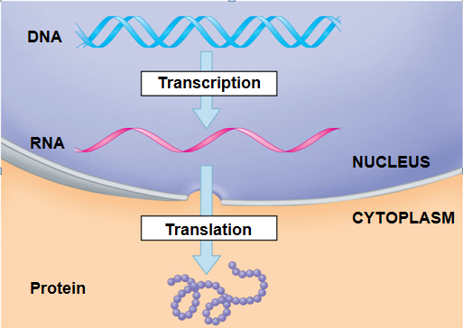

Slide 14
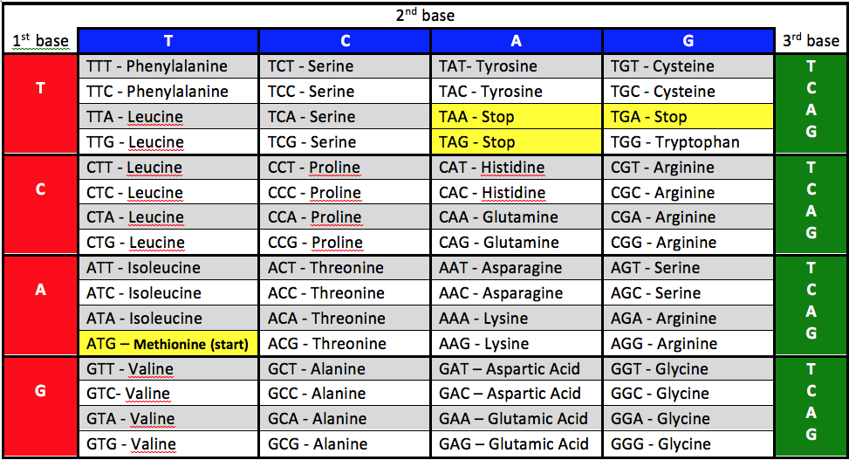
ATGGCAGGATGTTGA
Methionine – Alanine – Glycine – Cysteine - stop

Slide 15
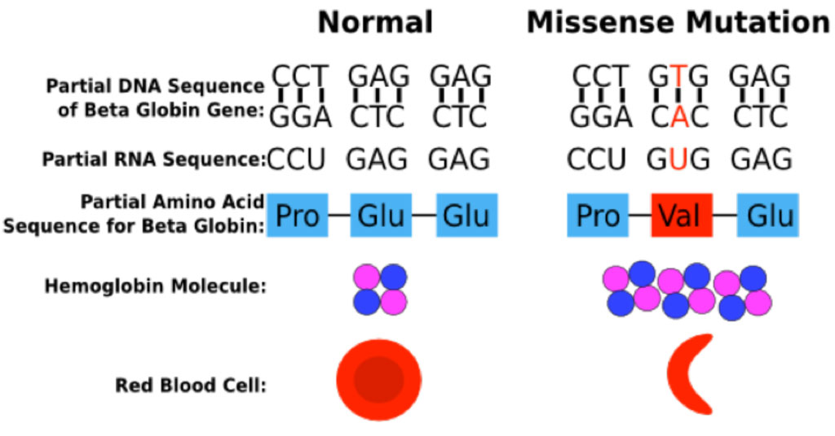
Mutations
A mutation is a change in the DNA sequence.
Mutations don’t always have negative effects.
A mutation may result in a different codon.
different amino acid in that protein
a stop codon may be formed where is should not be

Slide 16
Types of Mutations
Missense Mutation - single nucleotide change resulting in an amino acid substitution
Nonsense – single nucleotide change resulting in a stop codon.
Frameshift Mutation - insertion or deletion of a nucleotide

Slide 17
Codon Reading Questions
One of the largest genes in the human genome is the gene for the protein Dystrophin. The Dystropin protein has 3685 amino acids. Mutations in the Dystrophin gene can result in the genetic disease known as muscular dystrophy.
Muscular dystrophy is a group of diseases that cause progressive weakness and loss of muscle mass.
Some people who have muscular dystrophy will eventually lose the ability to walk. Some may have trouble breathing or swallowing.
There is no cure for muscular dystrophy. But medications and therapy can help manage symptoms and slow the course of the disease.

Slide 18
Answers
Below is the beginning of the gene sequence for the dystrophin gene. Using the DNA codon table, write down the amino acid sequence at the start of the Dystrophin protein.
5’…TTTTCAAAATGCTTTGGTGGGAAGAAGTAGAGGACTGTTA…3’
Methionine – Leucine – Tryptophan – Tryptophan – Glutamic Acid – Glutamic Acid – Valine – Glutamic Acid – Aspartic Acid – Cysteine …

Slide 19
Answers
The next sequence represents a mutation in the gene sequence for Dystrophin. Write down the new amino acid sequence.
normal
5’…TTTTCAAAATGCTTTGGTGGGAAGAAGTAGAGGACTGTTA…3’
5’…TTTTCAAAATGCTTTGGTGGGAATAAGTAGAGGACTGTTA…
Methionine – Leucine – Tryptophan – Tryptophan – Glutamic Acid – Stop

Slide 20
Answers
What type of mutation is this? Nonsense
What effect will this mutation have on the Dystrophin protein?
protein only has 6 amino acids
truncated protein
shortened protein
smaller protein
nonfunctional protein

Slide 21
Transcription and Translation (5th)
5’…. A T G C C C A G T G G C C T T G A T T G T T A T A T T G T G … 3’
DNA coding strand
3’.… T A C G G G T C A C C G G A A C T A A C A A T A T A A C A C … 5’
Template strand
Transcription
5’.… A U G C C C A G U G G C C U U G A U U G U U A U A U U G U G … 3’
RNA
Translation
Methionine-Proline-Serine-Glycine-Leucine-Aspartic Acid-Cysteine-Tyrosine-
Isoleucine-Valine…
(protein or amino acid sequence)

Slide 22
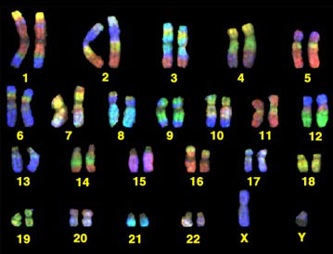
Chromosomes and Karyotypes
Chromosomes are packages of DNA
Humans have 23 pairs of chromosomes
22 autosomes
one set of sex chromosomes (X or Y)

Slide 23
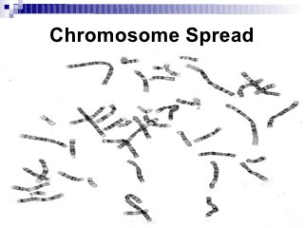
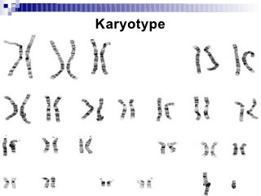
Karyotype Analysis
Scientists can isolate the chromosomes in one cell and view them under a microscope.
Karyotypes can identify a male or female and chromosome abnormalities such as missing or extra chromosomes.

Slide 24
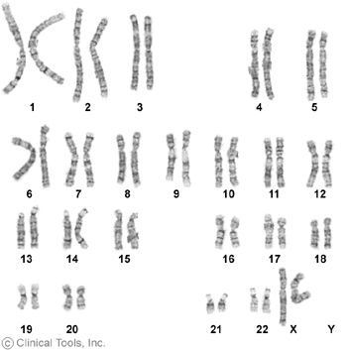
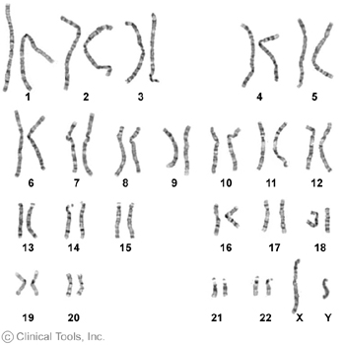
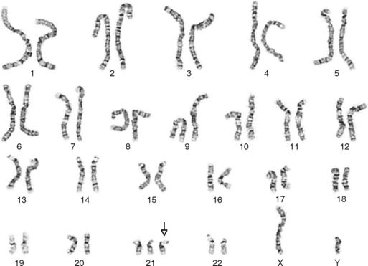
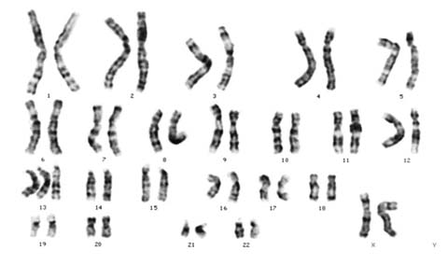
Karyotype Questions – page 4 & 5
A
B
C
D

Slide 25
A
B
C
D
Which individual(s) are female? A and D
Which individual(s) are male? B and C

Slide 26
A
B
C
D
How many chromosomes are present in a normal human? 46
Karyotype abnormalities?
C Downs Syndrome 47
D Trisomy 13 (would accept Patau) 47

Slide 27
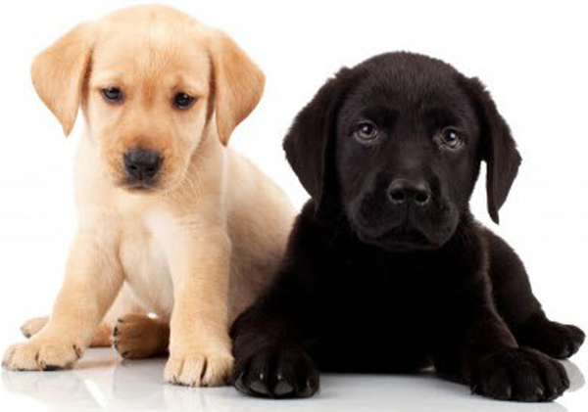
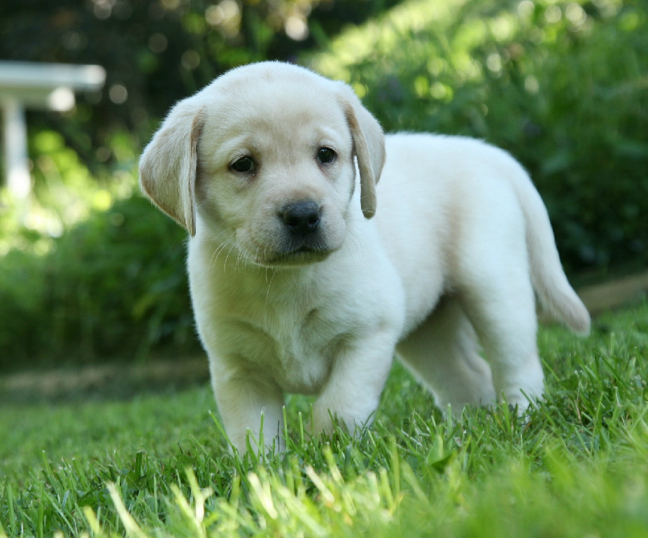
Classic Genetic Example
Coat Color in Dogs
(Note – this is a fictional example)
Alleles
Black (dominant), represented as B
Yellow (recessive), represented as b
Gene
Coat Color
Genotypes
Homozygous Dominant
BB
Heterozygous
Bb
Homozygous Recessive
bb
Phenotypes

Slide 28
Punnett Squares
Parental Genotypes:
Parent 1
Homozygous Dominant
black eyes
BB
Parent 2
Homozygous Recessive
red eyes
bb
b
b
These 4 squares represent the 4 possible genotypes. Each one is 25% of the total offspring.
B
Bb
Bb
B
Bb
Bb
* answers can be given in fractions
Possible Genotypes and %: Bb, 100%
Possible Phenotype and %: black eyes, 100%

Slide 29
Punnett Square Question – page 6
In humans, free earlobes (E) are dominant over attached earlobes (e).

Slide 30
Punnett Square - Answers
A heterozygous free earlobed male marries a female with attached earlobes.
What are the genotypes of this couple?
Male Ee Female ee
Using these genotypes, fill in the Punnett square below:
E
e
e
Ee
ee
e
Ee
ee

Slide 31
E
e
e
Ee
ee
e
Ee
ee
What are the possible genotypes of the offspring (children) and the expected percentages (or fraction) for each of these genotypes?
Ee – 50% or ½ ee – 50% or ½
What are the possible phenotypes of the offspring (children) and the expected percentages (or fraction) for each of these genotypes?
Free earlobes – 50% or ½ Attached earlobes – 50% or ½

Slide 32
Pedigree Analysis
Allows us to better understand the pattern of inheritance for a trait.
Uses family information to construct a pedigree chart or “family tree”

Slide 33
Pedigree Charts
* Most of the time an individual is not a known carrier. If an individual is an open circle or square, they may still be a carrier. Sometimes you can determine if an individual is a carrier based on information in the pedigree.

Slide 34
Pedigree Analysis
Dominant
Cannot be recessive as two affected parents could not have an unaffected child.
Recessive
Cannot be dominant as two unaffected parents could not have an affected child.
?
Might be dominant or recessive. More information is needed.

Slide 35
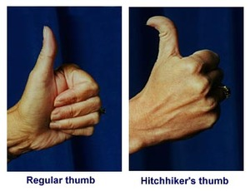
Pedigree Analysis
Hitchhiker’s thumb is a genetic trait in humans that allows some people to bend their thumb in an unusual shape.

Slide 36
Pedigree Analysis - Answers
1
2
3
4
5
6
7
8
9
10
11
12
13
14
Is individual #3 a male or female? male
What is the relationship between individuals # 10 and #11? siblings or brother/sister
What is the relationship between individuals # 8 and #9? married couple or husband and wife
How many generations are represented in this chart? 3
Which individuals have a hitchhiker’s thumb? 5, 7, 12

Slide 37
Pedigree Analysis - Answers
1
2
3
4
5
6
7
8
9
10
11
12
13
14
What is the most likely pattern of inheritance for hitchhikers thumb (dominant or recessive)?
autosomal recessive
What are the possible genotypes of the following individuals:
#1 Hh #9 Hh
#5 hh #14 Hh or HH

Slide 38
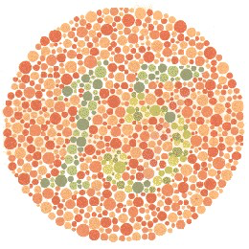
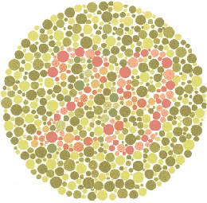
Red-Green Colorblindness

Slide 39
Pedigree Analysis (5th)
1
2
3
4
5
6
7
8
9
10
4
11
12
13
14
15
16
17
18
19
20
21
22
15
23
24
How many generations are represented in this chart? 4
In this pedigree, does red-green colorblindness affect more males or females?
males
What is the most likely pattern of inheritance for red-green colorblindness?
X linked recessive

Slide 40
Pedigree Analysis (5th)
1
2
3
4
5
6
7
8
9
10
4
11
12
13
14
15
16
?
?
15
17
18
19
20
21
22
23
24
In the above pedigree, identify all individuals that must be a carrier with a half filled symbol.

Slide 41
Human ABO Blood Group Genetics
Multiple alleles - A, B and O
Co-dominance - A and B alleles are both dominant over O and coexpressed when present together
genotype | AA | AO | BB | BO | AB | OO
phenotype | A | A | B | B | AB | O
blood type = phenotype

Slide 42
Human ABO Blood Group Genetics Question – page 9
Kate would like to trace the inheritance of blood types through her extended family.
Here is what Kate found out ….
Kate’s grandmother Mary has A blood type. Mary and her husband John had four children: two sons, Michael (blood type O) and David (blood type AB) and two daughters, Sue (blood type O) and Sally (blood type A). Michael married Kelly and they had two daughters, Anna (blood type A) and Kate (blood type B). Sally married Joe and they had three sons: Paul (blood type A), Max (blood type AB) and Ben (blood type O).

Slide 43
Human ABO Blood Group Genetics Answer
Mary
John
A
Kelly
Michael
David
Sue
Sally
Joe
O
AB
O
A
Anna
Kate
Paul
Max
Ben
A
B
A
AB
O

Slide 44
Human ABO Blood Group Genetics Answer
Mary
John
A
Kelly
Michael
David
Sue
Sally
Joe
O
AB
O
A
OO
AB
OO
Anna
Kate
Paul
Max
Ben
A
B
A
AB
O
AB
OO

Slide 45
Human ABO Blood Group Genetics Answer
Mary
John
A
AO
Kelly
Michael
David
Sue
Sally
Joe
O
AB
O
A
OO
AB
OO
AO
Anna
Kate
Paul
Max
Ben
A
B
A
AB
O
AO
BO
AO
AB
OO

Slide 46
Human ABO Blood Group Genetics Answer
Mary
John
A
B
AO
BO
Kelly
Michael
David
Sue
Sally
Joe
AB
O
AB
O
A
B
AB
OO
AB
OO
AO
BO
Anna
Kate
Paul
Max
Ben
A
B
A
AB
O
AO
BO
AO
AB
OO

Slide 47
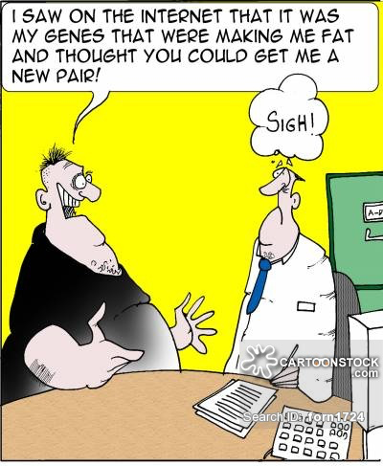
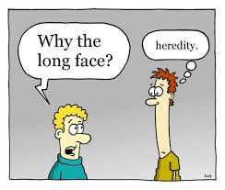
Good luck at WESO!

