Slide 1
Before we begin:
We want to know who is here! Please introduce yourself in the chat: Name. School.
Please mute your microphone to reduce background noise.
We will leave time for Q & A. Please submit your questions via the Google form that will be shared in the chat.
This presentation, along with the questions and answers, will be posted on the WESO website.

Slide 2
On Target
WESO
2026
Event Supervisors:
Glenn Timpe, Sukhinder Sandhu, Swathika Rajahmoney

Slide 3
Event Format
GRADES: 2, 3, 4, 5
TEAM SIZE: 3 participants (per grade)
DURATION: 30 minutes
The detailed event description can be found at: http://wesoscience.org/events/

Slide 4
Concepts Covered
Factors affecting the flight of the rockets
Consistency in the build and launch
Understanding of the forces acting on the rocket in flight
Ability to work as a team

Slide 5
EVENT SUMMARY
Teams build exactly six rockets using available materials.
Teams will launch rockets one at a time trying to get closer to a target with each launch.
4th & 5th graders will also take a short 5 question quiz.(multiple choice)
Final placement is determined by total distance from the target (the best 3 out of the 6 launches) discounted by the quiz

Slide 6
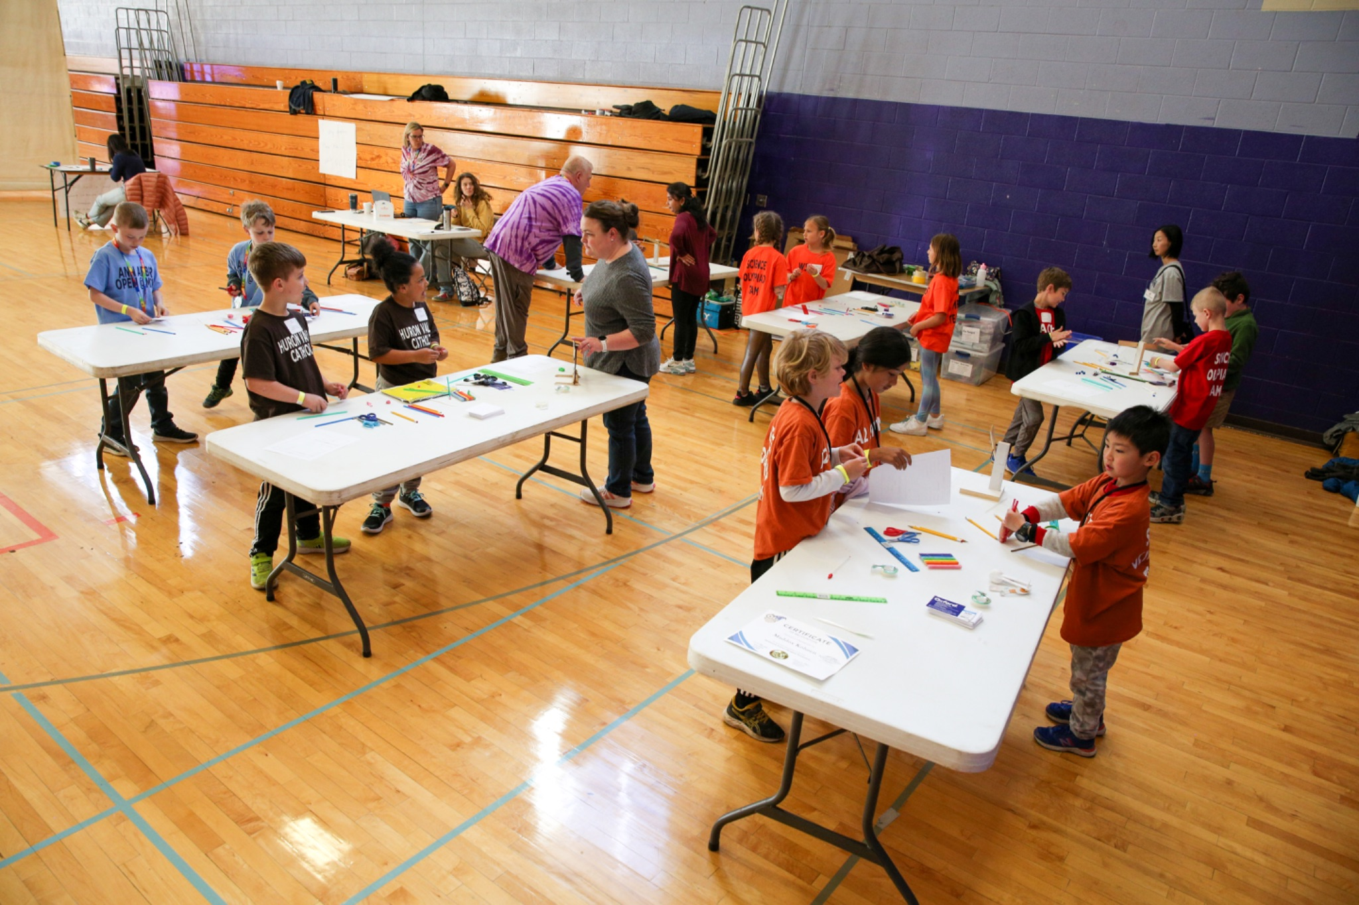
EVENT FLOW
Teams will check in and wait in the on deck area
4th & 5th graders will take a quiz.
Teams will proceed to the build area to build their straw rockets.
Teams will move to the Range when they are ready to launch their rockets.

Slide 7
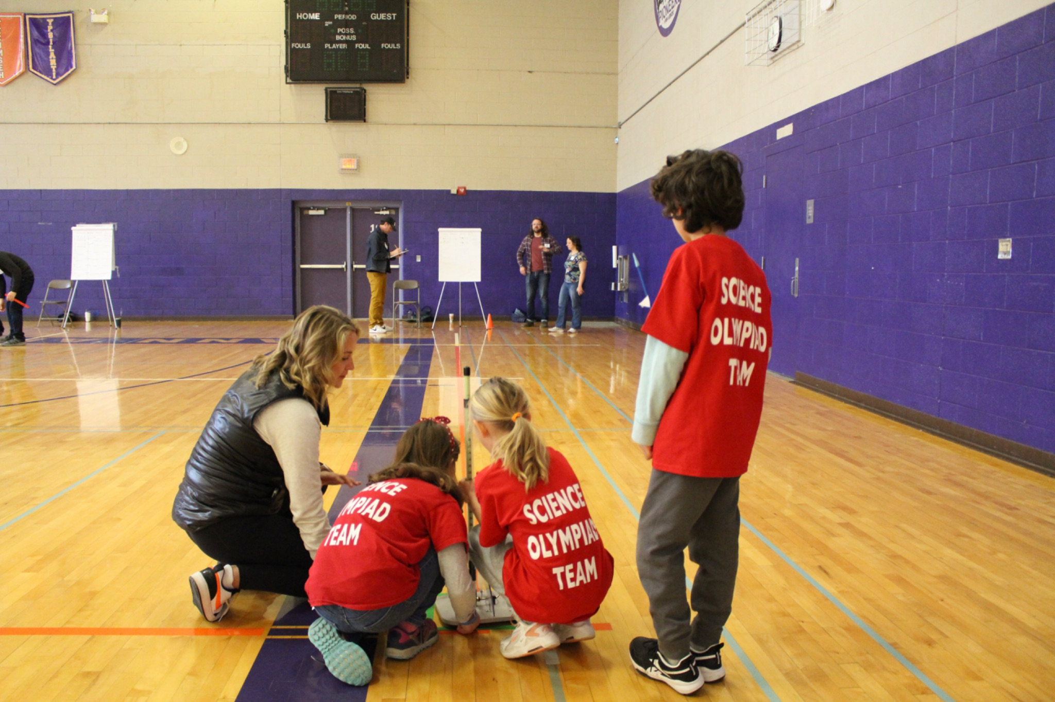
EVENT FLOW - CONTINUED
Teams will have 6 launches
They will receive their launch measurements from the range judges.
When they are finished launching they will take their measurements and exam to the scorer’s table.

Slide 8
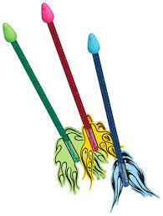
Building
No Strict Time Limit
Rockets must be between 10 cm and 25 cm in length.
Can use Materials provided to make:
Launch Guides
Measuring Guide
Aiming Guide
Materials Provided
Straws
Clay
Tape
Index Cards
Pencil
Scissors
Ruler
Measuring Spoons (you may bring your own)
Plastic Knife

Slide 9
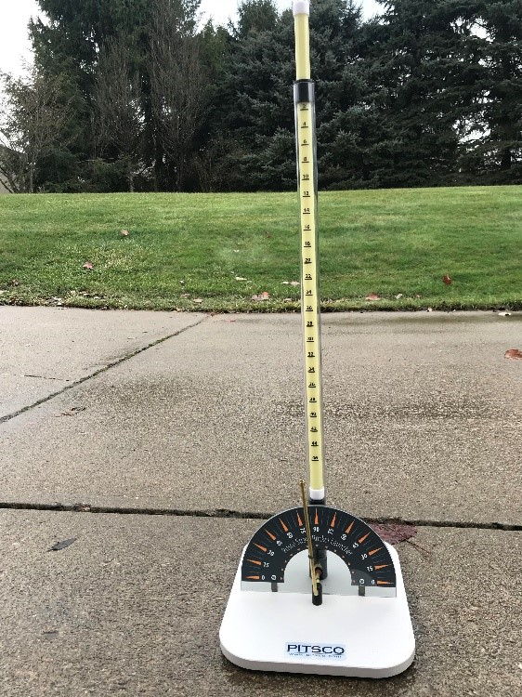
LAUNCHING
MUST share launch duties equally among team.
Must wait for ready-to-launch signal before each launch.
No time for major modifications to rockets once at the launch pad. Minor repairs are okay.
Judges will give feedback that should be incorporated into subsequent launches.

Slide 10
The Range
A B C
d

Slide 11
Feedback
Judges will measure distance from target line, distance from center line, and distance from target.
Judges provide feedback graphically after each launch
X: 35
26
42
Z: 22
X
Z

Slide 12
SCORING
Total of Best 3 Launches
4th & 5th Grade Launches reduced by quiz score
5 questions (each correct answer will reduce distance by 2cm)
Example:
Launch Distances: 91 cm, 52 cm, 19 cm, 2 cm, 11 cm, 15 cm
Best 3: 2cm+11cm+15cm=28 cm
Quiz Score: 4 right answers (4x2cm=8cm)
Team Total Score: 28cm-8cm=20 cm

Slide 13
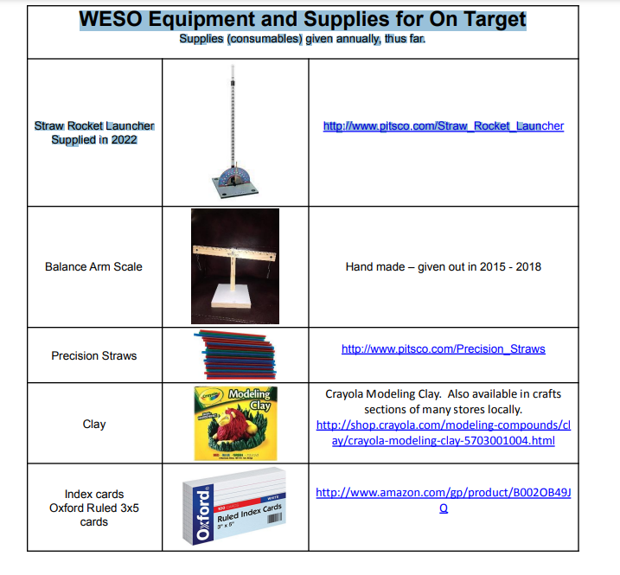

Event Materials distributed by WESO
New ones given out in 2023 or later
Ask your Head Coach for these items!
https://www.amazon.com/dp/B011Q25T6K

Slide 14
Additional Resources
Study guides (found at wesoscience.org/on-target/)
Coaching of Physics
On Target Practice Outline
Websites (Pitsco user guides - also on website above)
YouTube
Prior Students

Slide 15
COACHING ADVICE
Help students discover the variables (1 at a time) and help them develop the tools to fix or control them.
Focus on teamwork and problem solving
Help students figure out how to build 6 similar rockets.
Try to launch rockets at every meeting.
Make sure they support each other.
Have a mock competition between team members
Have Fun!!

Slide 16

Questions after tonight?
New for 2025!
WESO Discord Server
Every WESO event will have its own channel
Join the WESO server to submit your questions in the event chat
Event supervisors or WESO board members will monitor the discussion and answer questions
Event coaches can use the chat to exchange coaching ideas
Go to wesoscience.org/events/ for details on how to join the WESO server and guidelines for its use

Slide 17
QUESTIONS NOW?
Please submit your questions now using the Google form that was shared with you in the chat.
We will answer live and post all questions and written answers to the website following the meeting.
Thank you for serving as an event coach and helping us bring back WESO to our community!

